Slide 1


Global warming

Slide 2
CLIMATE CREW TEAM
Team members
d.VENKATVINAY
PROJECT NAME
GLOBAL WARMING

Slide 3
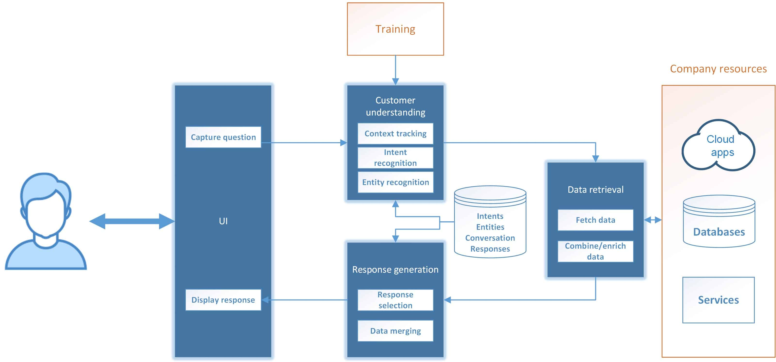
CHATBOT ARCHITECTURE

Slide 4
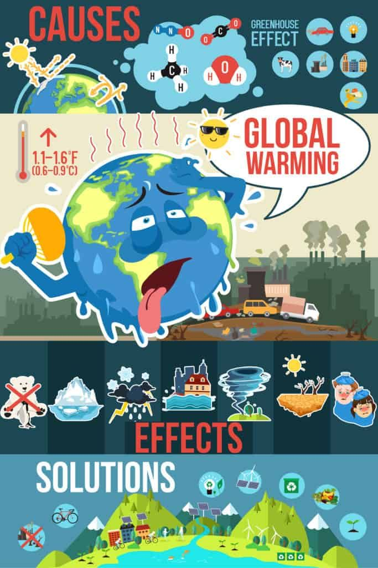
CHARTBOT ASSISTANT

Slide 5
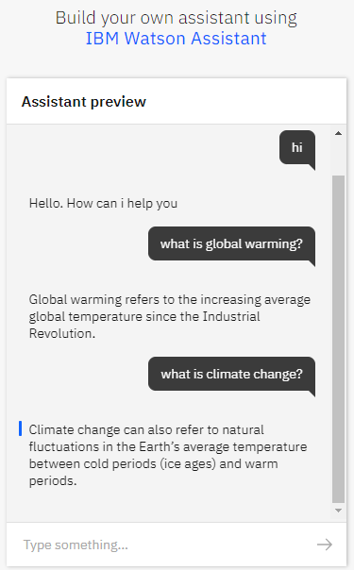
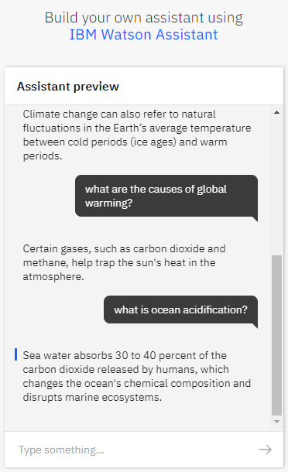

Slide 6
How the Assistant Works?
The three main components of Watson Assistant are Intents, Entities, and Dialog. Intents are sets of user examples to train Watson Assistant. They represent the questions that a user might ask. Entities are dictionaries of keywords and patterns, and the Dialog is the flow of the conversation, where we can build nodes and link them to our intents and entities to design and handle the conversation. Each assistant has its intents and entities, and we trained the assistant using common words among different dialects to make it understand questions.

Slide 7
SOURCE CODE
https://web-chat.global.assistant.watson.cloud.ibm.com/preview.html?region=eu-gb&integrationID=c465c32b-f40a-47eb-9852-8a0bc8b0f343&serviceInstanceID=ef09a6f0-51f7-45d5-aedb-97bafcbab601

